Slide 1
MA3077 (DLI) Operational Research Lecture 24 – line search algorithms
Dr Marco Fasondini

Slide 2
Recap and plan of the day
Recap: in the previous lecture we studied the fundamentals of unconstrained optimisation.
In this lecture: Line search methods to compute approximate minimisers, following Ch. 3 of the book Numerical Optimization by Jorge Nocedal and Stephen J. Wright.

Slide 3
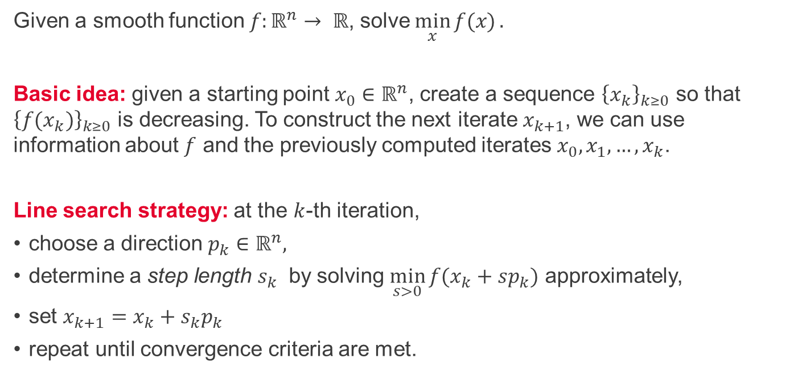
Line search methods
Given a smooth function $f:ℝ^{n}→ ℝ$, solve$\min_{x}{f(x)}.$
Basic idea: given a starting point $x_{0}∈ℝ^{n}$, create a sequence ${\left\{x_{k}\right\}}_{k≥0}$ so that ${\left\{{f(x}_{k})\right\}}_{k≥0}$ is decreasing. To construct the next iterate $x_{k+1}$, we can use information about $f$ and the previously computed iterates $x_{0}, x_{1}, …, x_{k}$.
Line search strategy: at the $k$-th iteration,
choose a direction $p_{k}∈ℝ^{n},$
determine a step length $s_{k}$ by solving $\min_{s>0}{f(x_{k}+sp_{k})}$ approximately,
set $x_{k+1}=x_{k}+s_{k}p_{k}$
repeat until convergence criteria are met.

Slide 4
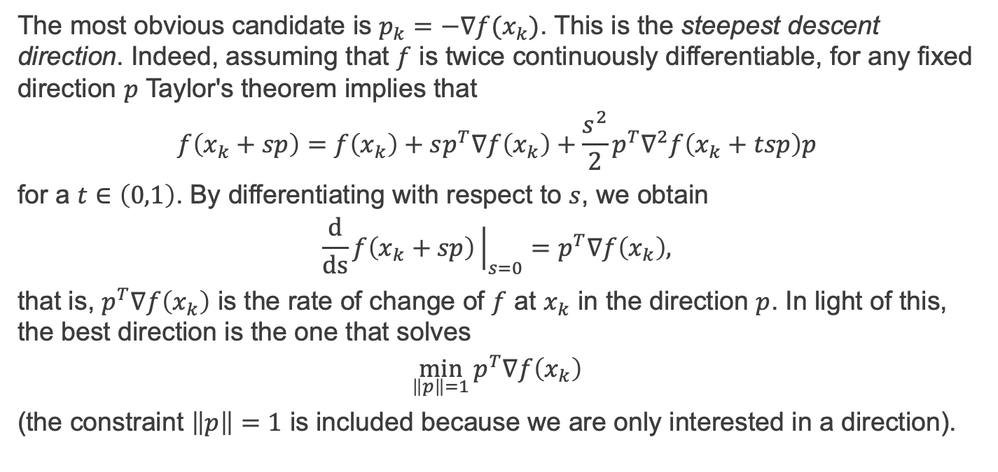
Steepest descent direction 1/2
The most obvious candidate is $p_{k}=−∇f(x_{k})$. This is the steepest descent direction. Indeed, assuming that $f$ is twice continuously differentiable, for any fixed direction $p$ Taylor's theorem implies that
$$f\left(x_{k}+sp\right)=f\left(x_{k}\right)+sp^{T}∇f\left(x_{k}\right)+\frac{s^{2}}{2}p^{T}∇^{2}f\left(x_{k}+tsp\right)p$$
for a $t∈\left(0,1\right)$. By differentiating with respect to $s$, we obtain
$$\frac{d}{ds}f\left(x_{k}+sp\right){\left.​\right|}_{s=0}=p^{T}∇f\left(x_{k}\right),$$
that is, $p^{T}∇f\left(x_{k}\right)$ is the rate of change of $f$ at $x_{k}$ in the direction $p$. In light of this, the best direction is the one that solves
$$\min_{\left\|p\right\|=1}{p^{T}∇f\left(x_{k}\right)}$$
(the constraint $\left\|p\right\|=1$ is included because we are only interested in a direction).

Slide 5
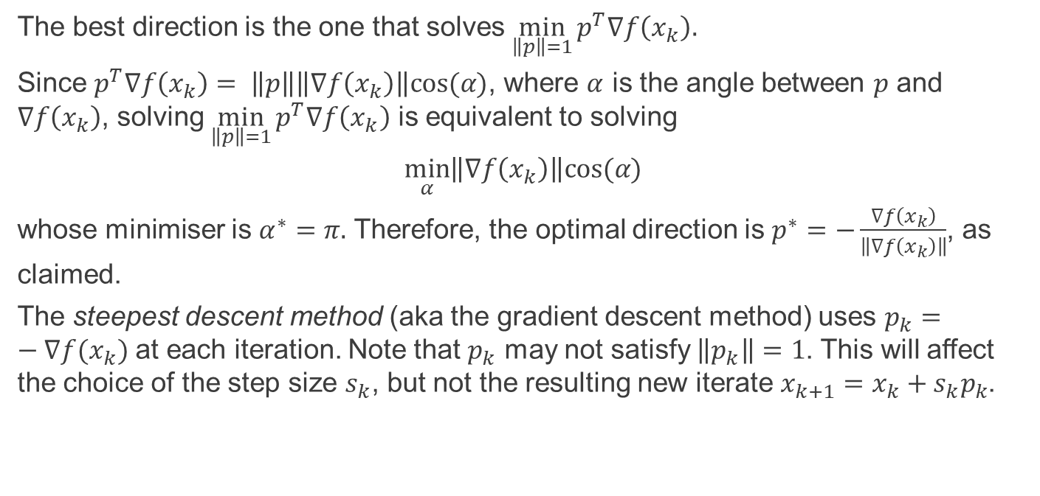
Steepest descent direction 1/2
The best direction is the one that solves$\min_{\left\|p\right\|=1}{p^{T}∇f\left(x_{k}\right).}$
Since $p^{T}∇f\left(x_{k}\right)= \left\|p\right\|\left\|∇f\left(x_{k}\right)\right\|cos⁡(α)$, where $α$ is the angle between $p$ and $∇f\left(x_{k}\right)$, solving $\min_{\left\|p\right\|=1}{p^{T}∇f\left(x_{k}\right)}$ is equivalent to solving
$$\min_{α}\left\|∇f\left(x_{k}\right)\right\|cos⁡(α)$$
whose minimiser is $α^{∗}=π.$ Therefore, the optimal direction is $p^{∗}=−\frac{∇f\left(x_{k}\right)}{\left\|∇f\left(x_{k}\right)\right\|}$, as claimed.
The steepest descent method (aka the gradient descent method) uses $p_{k}=−∇f(x_{k})$ at each iteration. Note that $p_{k}$ may not satisfy $\left\|p_{k}\right\|=1$. This will affect the choice of the step size $s_{k}$, but not the resulting new iterate $x_{k+1}=x_{k}+s_{k}p_{k}$.

Slide 6
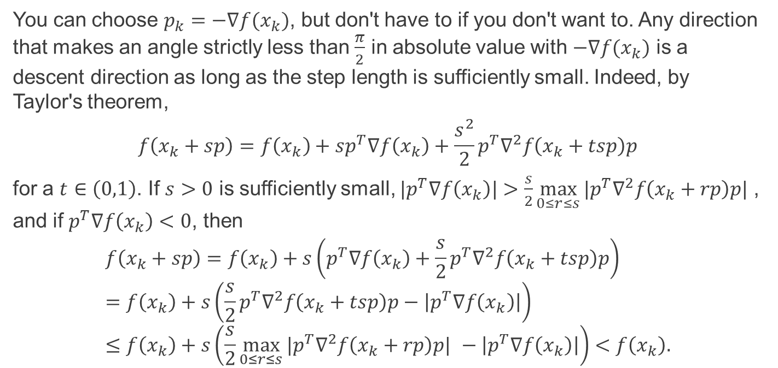
Descent directions
You can choose $p_{k}=−∇f(x_{k})$, but don't have to if you don't want to. Any direction that makes an angle strictly less than $\frac{π}{2}$ in absolute value with $−∇f(x_{k})$ is a descent direction as long as the step length is sufficiently small. Indeed, by Taylor's theorem,
$$f\left(x_{k}+sp\right)=f\left(x_{k}\right)+sp^{T}∇f\left(x_{k}\right)+\frac{s^{2}}{2}p^{T}∇^{2}f\left(x_{k}+tsp\right)p$$
for a $t∈\left(0,1\right)$. If $s>0$ is sufficiently small, $|p^{T}∇f\left(x_{k}\right)|>\frac{s}{2}\max_{0≤r≤s}{{{|p}^{T}∇}^{2}f\left(x_{k}+rp\right)p| }$, and if $p^{T}∇f\left(x_{k}\right)<0$, then
$$f\left(x_{k}+sp\right)=f\left(x_{k}\right)+s\left(p^{T}∇f\left(x_{k}\right)+\frac{s}{2}p^{T}∇^{2}f\left(x_{k}+tsp\right)p\right) \\ =f\left(x_{k}\right)+s\left(\frac{s}{2}p^{T}∇^{2}f\left(x_{k}+tsp\right)p−\left|p^{T}∇f\left(x_{k}\right)\right|\right) \\ ≤f\left(x_{k}\right)+s\left(\frac{s}{2}\max_{0≤r≤s}{{{|p}^{T}∇}^{2}f\left(x_{k}+rp\right)p| }−\left|p^{T}∇f\left(x_{k}\right)\right|\right)<f\left(x_{k}\right).$$

Slide 7
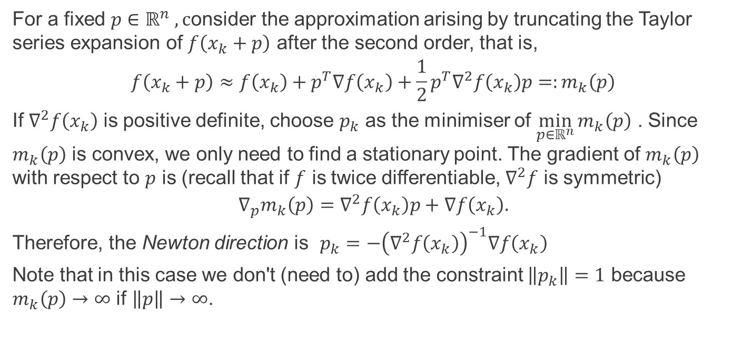
The Newton direction 1/2
For a fixed $p∈ℝ^{n} , c$onsider the approximation arising by truncating the Taylor series expansion of $f\left(x_{k}+p\right)$ after the second order, that is,
$$f\left(x_{k}+p\right)≈f\left(x_{k}\right)+p^{T}∇f\left(x_{k}\right)+\frac{1}{2}p^{T}∇^{2}f\left(x_{k}\right)p=:m_{k}\left(p\right)$$
If $∇^{2}f\left(x_{k}\right)$ is positive definite, choose $p_{k}$ as the minimiser of $\min_{p∈ℝ^{n}}{m_{k}\left(p\right)}$ . Since $m_{k}\left(p\right)$ is convex, we only need to find a stationary point. The gradient of $m_{k}\left(p\right)$ with respect to $p$ is (recall that if $f$ is twice differentiable, $∇^{2}f$ is symmetric)
$${∇_{p}m}_{k}\left(p\right)=∇^{2}f\left(x_{k}\right)p+∇f\left(x_{k}\right).$$
Therefore, the Newton direction is $p_{k}=−{\left(∇^{2}f\left(x_{k}\right)\right)}^{−1}∇f\left(x_{k}\right)$
Note that in this case we don't (need to) add the constraint $\left\|p_{k}\right\|=1$ because $m_{k}\left(p\right)→∞$ if $\left\|p\right\|→∞$.

Slide 8
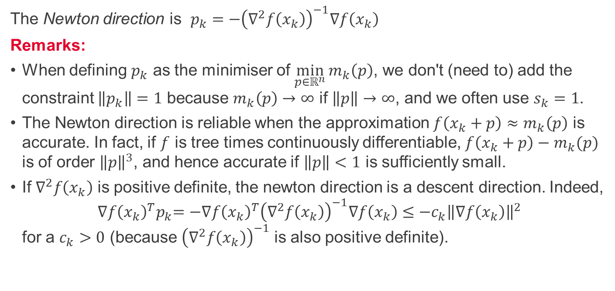
The Newton direction 2/2
The Newton direction is $p_{k}=−{\left(∇^{2}f\left(x_{k}\right)\right)}^{−1}∇f\left(x_{k}\right)$
Remarks:
When defining $p_{k}$ as the minimiser of $\min_{p∈ℝ^{n}}{m_{k}\left(p\right)}$, we don't (need to) add the constraint $\left\|p_{k}\right\|=1$ because $m_{k}\left(p\right)→∞$ if $\left\|p\right\|→∞$, and we often use $s_{k}=1$.
The Newton direction is reliable when the approximation $f\left(x_{k}+p\right)≈m_{k}\left(p\right)$ is accurate. In fact, if $f$ is tree times continuously differentiable, $f\left(x_{k}+p\right)−m_{k}(p)$ is of order ${\left\|p\right\|}^{3}$, and hence accurate if $\left\|p\right\|<1$ is sufficiently small.
If $∇^{2}f\left(x_{k}\right)$ is positive definite, the newton direction is a descent direction. Indeed, ${∇f{\left(x_{k}\right)}^{T}p}_{k}=−∇f{\left(x_{k}\right)}^{T}{\left(∇^{2}f\left(x_{k}\right)\right)}^{−1}∇f\left(x_{k}\right)≤−c_{k}{\left\|∇f\left(x_{k}\right)\right\|}^{2}$ for a $c_{k}>0$ (because ${\left(∇^{2}f\left(x_{k}\right)\right)}^{−1}$ is also positive definite).

Slide 9
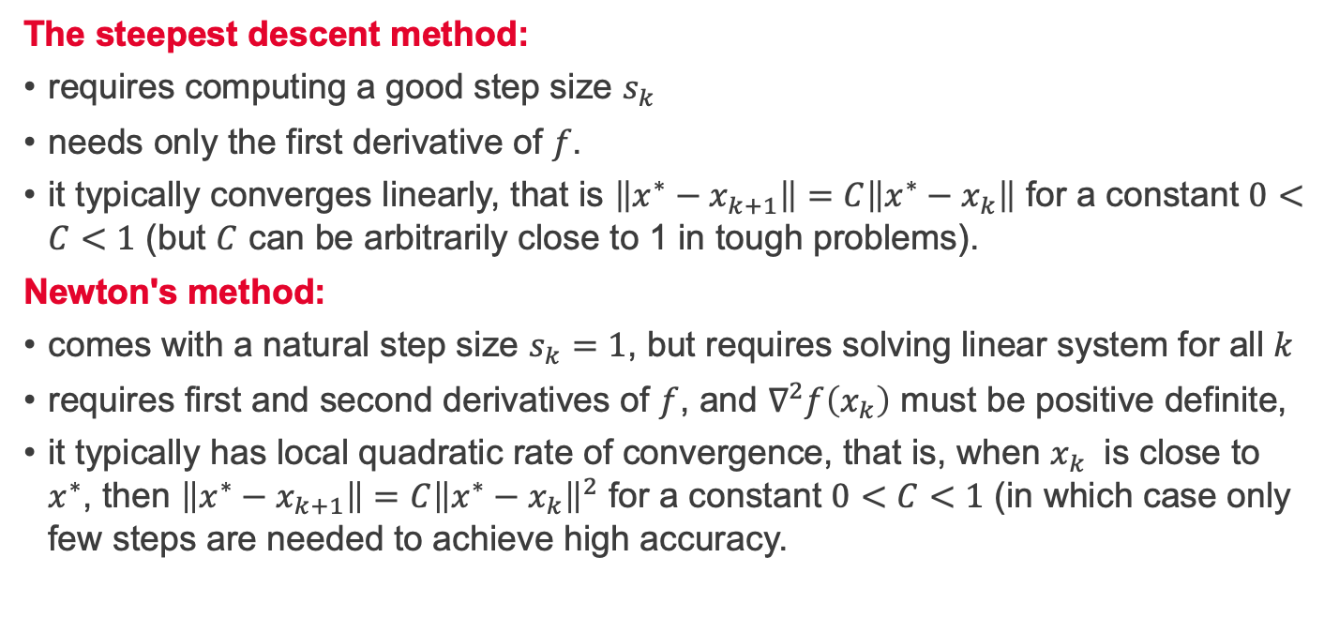
Steepest descent vs Newton's method
The steepest descent method:
requires computing a good step size $s_{k}$
needs only the first derivative of $f$.
it typically converges linearly, that is $\left\|x^{∗}−x_{k+1}\right\|=C\left\|x^{∗}−x_{k}\right\|$ for a constant $0<C<1$ (but $C$ can be arbitrarily close to 1 in tough problems).
Newton's method:
comes with a natural step size $s_{k}=1$, but requires solving linear system for all $k$
requires first and second derivatives of $f$, and $∇^{2}f\left(x_{k}\right)$ must be positive definite,
it typically has local quadratic rate of convergence, that is, when $x_{k}$ is close to $x^{∗}$, then $\left\|x^{∗}−x_{k+1}\right\|=C{\left\|x^{∗}−x_{k}\right\|}^{2}$ for a constant $0<C<1$ (in which case only few steps are needed to achieve high accuracy.

Slide 10
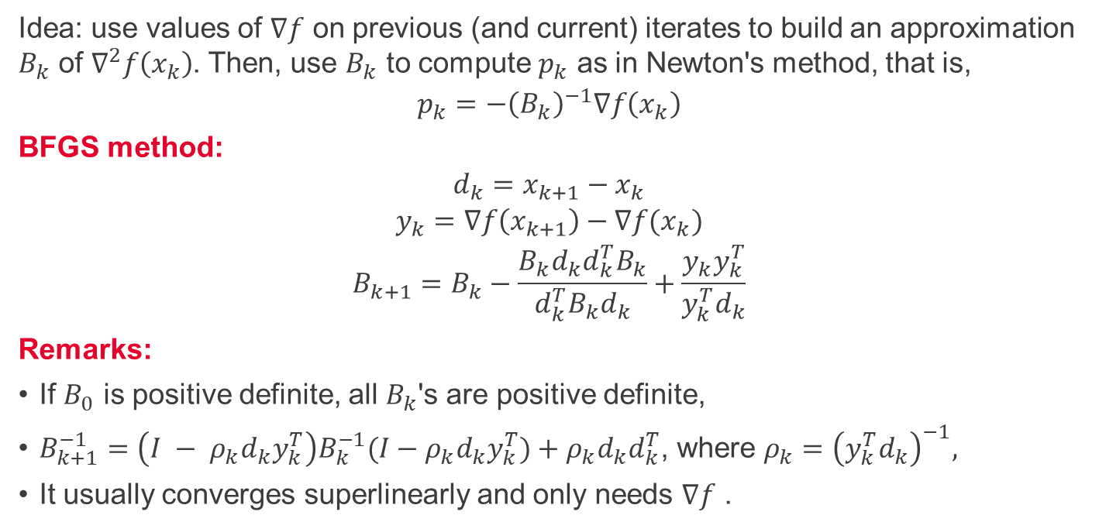
Quasi-Newton's methods - BFGS
Idea: use values of $∇f$ on previous (and current) iterates to build an approximation $B_{k}$ of $∇^{2}f\left(x_{k}\right)$. Then, use $B_{k}$ to compute $p_{k}$ as in Newton's method, that is,
$$p_{k}=−{\left(B_{k}\right)}^{−1}∇f\left(x_{k}\right)$$
BFGS method:
$$\begin{aligned}d_{k}=x_{k+1}−x_{k} \\ y_{k}=∇f\left(x_{k+1}\right)−∇f(x_{k}) \\ B_{k+1}=B_{k}−\frac{B_{k}d_{k}d_{k}^{T}B_{k}}{d_{k}^{T}B_{k}d_{k}}+\frac{y_{k}y_{k}^{T}}{y_{k}^{T}d_{k}}\end{aligned}$$
Remarks:
If $B_{0}$ is positive definite, all $B_{k}$'s are positive definite,
$B_{k+1}^{−1}=\left(I − ρ_{k}d_{k}y_{k}^{T}\right)B_{k}^{−1}(I−ρ_{k}d_{k}y_{k}^{T})+ρ_{k}d_{k}d_{k}^{T}$, where $ρ_{k}={\left(y_{k}^{T}d_{k}\right)}^{−1},$
It usually converges superlinearly and only needs $∇f$ .

Slide 11
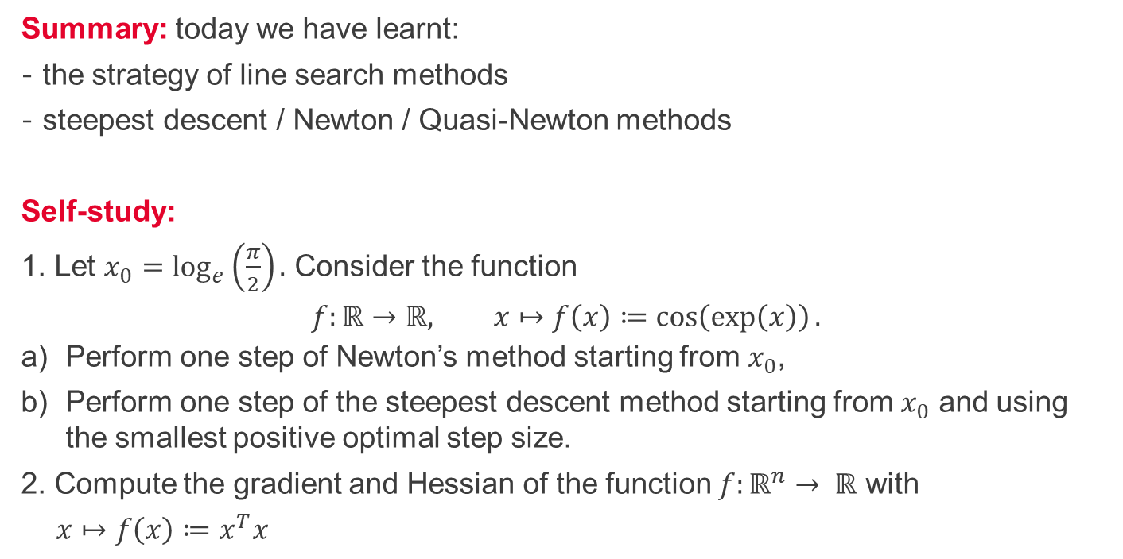
Summary and self-study
Summary: today we have learnt:
the strategy of line search methods
steepest descent / Newton / Quasi-Newton methods
Self-study:
1. Let $x_{0}=\log_{e}\left(\frac{π}{2}\right).$ Consider the function
$$f:ℝ→ℝ, x↦f\left(x\right)≔\cos\left(\exp\left(x\right)\right).$$
Perform one step of Newton’s method starting from $x_{0}$,
Perform one step of the steepest descent method starting from $x_{0}$ and using the smallest positive optimal step size.
2. Compute the gradient and Hessian of the function $f:ℝ^{n}→ ℝ$ with
$x↦f\left(x\right)≔x^{T}x$

